Slide 1
The Limit of a Function
Copyright © Cengage Learning. All rights reserved.

Slide 2
Topics for this week: Limits and Continuity
Part I: Definitions and Notations
Definitions of Left-hand limit, right-hand limit, limit, continuity
Notation of left-hand limit, right-hand limit, limit
Part II: Estimating limits by numerical method and graphical method
Part III: Evaluating limits algebraically

Slide 3
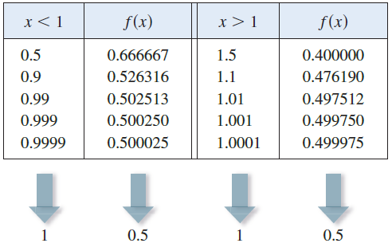
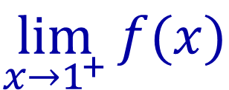

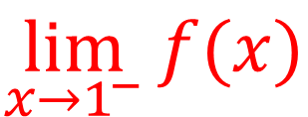

An example
Let’s investigate the behavior of the function f defined by
for values of x near 1.
The following table gives values of f (x) for values of x close to 1 but not equal to 1.
$$\lim_{x→1^{−}}{f(x)}$$
$$=0.5$$
$$\lim_{x→1^{+}}{f(x)}$$
$$=0.5$$
0.9
0.99
0.999
1.1
1.3
1

Slide 4
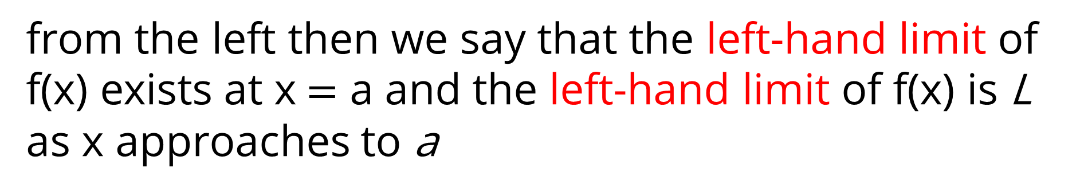





Definition of left-hand limit
Left-hand limit:
If
$$f(x)$$
approaches to
$$L$$
when
$$x$$
approaches to
$$a$$
from the left then we say that the left-hand limit of f(x) exists at x $=$ a and the left-hand limit of f(x) is L as x approaches to a
Notation:
$$\lim_{x→a^{−}}{f(x)}=L$$

Slide 5
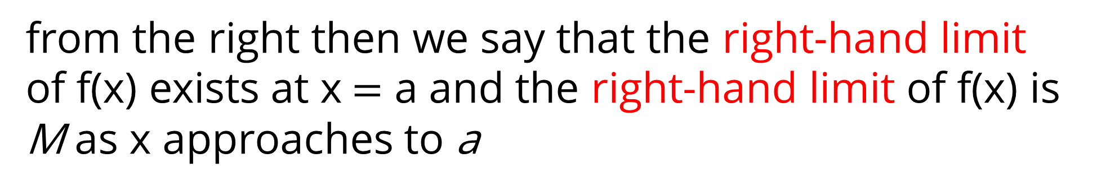


Definition of right-hand limit
Right-hand limit:
If
$$f(x)$$
approaches to
$$M$$
when
$$x$$
approaches to
$$a$$
from the right then we say that the right-hand limit of f(x) exists at x $=$ a and the right-hand limit of f(x) is M as x approaches to a
Notation:
$$\lim_{x→a^{+}}{f(x)}=M$$

Slide 6
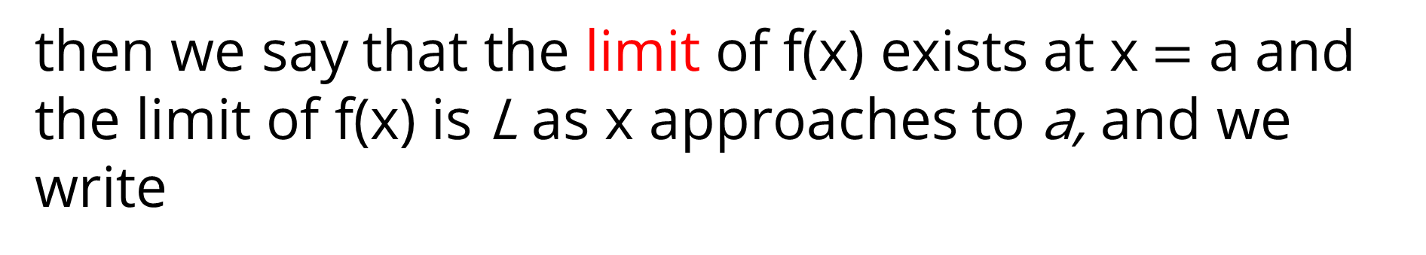

Definition of Limit
Limit:
$$\lim_{x→a^{−}}{f(x)}=\lim_{x→a^{+}}{f(x)}=L$$
If
then we say that the limit of f(x) exists at x $=$ a and the limit of f(x) is L as x approaches to a, and we write
$$\lim_{x→a}{f(x)}=L$$

Slide 7

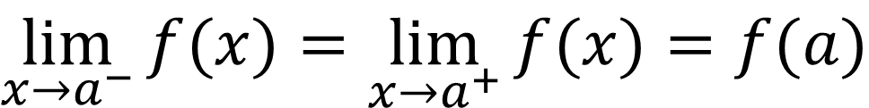
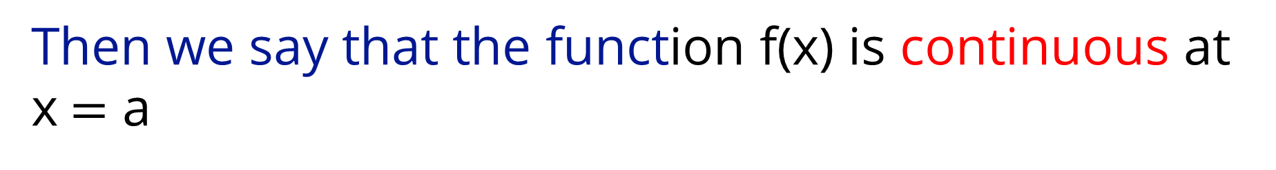
Definition of Continuity
$$f(a)$$
If exists and
$$\lim_{x→a^{−}}{f(x)}=\lim_{x→a^{+}}{f(x)}=f(a)$$
Then we say that the function f(x) is continuous at x $=$ a

Slide 8
Intuitive Definition of a Limit
1 Intuitive Definition of a Limit Suppose f (x) is defined when x is near the number a. (This means that f is defined on some open interval that contains a, except possibly at a itself.) Then we write
a
and say "the limit of f (x), as x approaches a, equals L“, if we can make the values of f (x) arbitrarily close to L (as close to L as we like) by restricting x to be sufficiently close to a (on either side of a) but not equal to a.
This says that the values of f (x) approach L as x approaches a. In other words, the values of f (x) tend to get closer and closer to the number L as x gets closer and closer to the number a (from either side of a) but x ≠ a.

Slide 9
Intuitive definition of One-Sided Limits
2 Intuitive Definition of One-Sided Limits We write
and say that the left-hand limit of f (x) as x approaches a [or the limit of f (x) as x approaches a from the left] is equal to L if we can make the values of f (x) arbitrarily close to L by restricting x to be sufficiently close to a with x less than a.
We write
and say that the right-hand limit of f (x) as x approaches a [or the limit of f (x) as x approaches a from the right] is equal to L if we can make the values of f (x) arbitrarily close to L by restricting x to be sufficiently close to a with x greater than a.

Slide 10

Notations:
$$\lim_{x→a^{−}}{f(x)}$$
Left hand limit:
$$\lim_{x→a^{+}}{f(x)}$$
Right hand limit:
$$\lim_{x→a}{f(x)}$$
Limit:

Slide 11
Alternative notation
An alternative notation for
is
which is usually read “f (x) approaches L as x approaches a.”
Notice the phrase “but x not equal to a” in the definition of limit. This means that in finding the limit of f (x) as x approaches a, we never consider x = a. In fact, f (x) need not even be defined when x = a. The only thing that matters is how f is defined near a.

Slide 12
Estimating Limits Numerically and Graphically

Slide 13
Evaluate and Estimate Limits
We can estimate a limit
Numerically
Graphically
We can evaluate a limit
Algebraically

Slide 14
Estimating Limits Numerically and Graphically
Let’s investigate the behavior of the function f defined by
for values of x near 1.
The following table gives values of f (x) for values of x close to 1 but not equal to 1.
$$\lim_{x→1^{−}}{f(x)}$$
$$=0.5$$
$$\lim_{x→1^{+}}{f(x)}$$
$$=0.5$$
.0.9
.0.99
.0.999
1.1
1.3
1

Slide 15
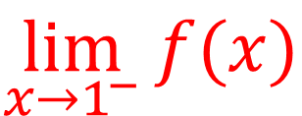

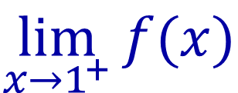

Estimating Limits Numerically and Graphically
From the table and the graph of f shown in Figure 1 we see that the closer x is to 1 (on either side of 1), the closer f (x) is to 0.5.
$$\lim_{x→1^{+}}{f(x)}$$
$$=0.5$$
$$\lim_{x→1^{−}}{f(x)}$$
$$=0.5$$
Figure 1

Slide 16
Estimating Limits Numerically and Graphically
In fact, it appears that we can make the values of f (x) as close as we like to 0.5 by taking x sufficiently close to 1.
We express this by saying “the limit of the function
as x approaches 1 is equal to 0.5.”
The notation for this is

Slide 17
Example
Guess the value of
Solution:
The function
is not defined when x = 0. Using a calculator
(and remembering that, if
sin x means the sine of the angle whose radian
measure is x), we construct a table of values correct to eight decimal places.

Slide 18
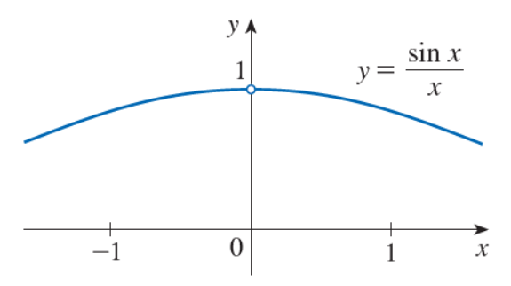
Example – Solution
From the table below and the graph in Figure 4,
Year | sin x/x
±1.0 | 0.84147098
±0.5 | 0.95885108
±0.4 | 0.97354586
±0.3 | 0.98506736
±0.2 | 0.99334665
±0.1 | 0.99833417
±0.05 | 0.99958339
±0.01 | 0.99998333
±0.005 | 0.99999583
±0.001 | 0.99999983
Figure 4
we guess that

Slide 19
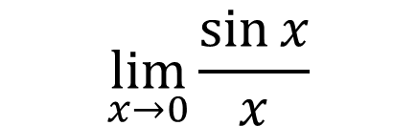
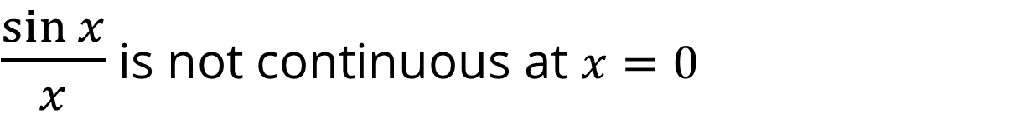


Example – Solution
$$\lim_{x→0}{\frac{\sin{x}}{x}}$$
$$\frac{\sin{x}}{x}$$
exists but
is undefined at $x=0$
Therefore
$\frac{\sin{x}}{x}$ is not continuous at $x=0$

Slide 20


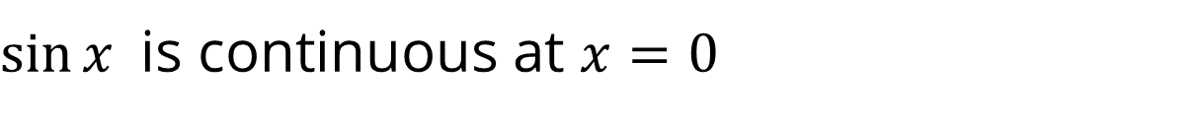



Example
Guess the value of
$$\lim_{x→0}{\sin\left(x\right)}$$
$$\lim_{x→0^{−}}{\sin\left(x\right)=0}$$
$$\lim_{x→0^{+}}{\sin\left(x\right)=0}$$
and
Therefore
$$\lim_{x→0}{\sin\left(x\right)=0}$$
Also
$$\sin\left(0\right)=0$$
Therefore
$\sin{x}$is continuous at $x=0$

Slide 21
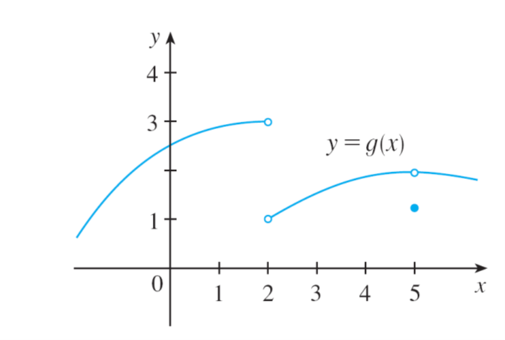


Example
The graph of a function g is shown in Figure 7. Use the graph to state the values (if they exist) of the following:
(a)
(b)
(c)
(d)
$$g(2)$$
(e)
(f)
(g)
(h)
$$g(5)$$
Figure 7

Slide 22
Example – Solution
Looking at the graph we see that the values of g(x) approach 3 as x approaches 2 from the left, but they approach 1 as x approaches 2 from the right.
Therefore
(a)
and (b)
(c) Since the left and right limits are different, we conclude that
does not exist.
(d) According to the graph g(2) is undefined
The function is not continuous at 2

Slide 23

Example – Solution
The graph also shows that
(e)
and (f)
(g) This time the left and right limits are the same and so, we have
(h) g(5) = 1.2
The function g(x) is not continuous at 5 because
$$\lim_{x→5}{g(x)}≠g(5)$$

Slide 24
Evaluating Limits using the Limit Laws, Theorems and known results
Copyright © Cengage Learning. All rights reserved.

Slide 25

Evaluating Limits
$$ε,δ definition of limit$$
Limit laws
Basic limits
Thorems

Slide 26
Properties of Limits

Slide 27


Properties of Limits
In this section we use the following properties of limits, called the Limit Laws, to calculate limits.
Limit Laws Suppose that c is a constant and the limits
exist. Then
1.
4.
2.
$$\lim_{x→a}{f(g\left(x\right))=f\left(\lim_{x→a}{g(x)}\right)}$$
5.
3.
provided f is continuous at
$$\lim_{x→a}{g(x)}$$

Slide 28
Properties of Limits
6.
7.
8.
9.

Slide 29


Properties of Limits
The first five laws can be stated verbally as follows:
Constant Multiple Law
1. The limit of a constant times a function is the constant times the limit of the function.
Sum Law
2. The limit of a sum is the sum of the limits.
Product Law
3. The limit of a product is the product of the limits.
Quotient Law
4. The limit of a quotient is the quotient of the limits (provided that the limit of the denominator is not 0).
$$\lim_{x→a}{f(g\left(x\right))=f\left(\lim_{x→a}{g(x)}\right)}$$
Composition Law
5.
Provided, f is continuous at
$$\lim_{x→a}{g(x)}$$

Slide 30
Properties of Limits
Intuitively, if f (x) is close to L and g (x) is close to M, it is reasonable to conclude that f (x) + g (x) is close to L + M.

Slide 31
Properties of Limits
If we use the Product Law repeatedly with g(x) = f (x), we obtain the following law.
Power Law
6.
Root Law
7.
Two special limits:
8.
9.

Slide 32
Properties of Limits
Law 8 and law 9 are obvious from an intuitive point of view (state them in words or draw graphs of y = c and y = x).
If we now put f (x) = x in Law 6 and use Law 9, we get another useful special limit for power functions.
10.
If we put f (x) = x in Law 7 and use Law 9, we get a similar special limit for roots.
11.

Slide 33
Definition
Direct Substitution Property If f is a continuous function and a is in the domain of f, then
(Evaluating Limits by Continuity)

Slide 34
Theorem
If f(x) = g(x) when x ≠ a, then
provided the limits exist.

Slide 35
Theorem
The following two theorems describe how the limits of functions are related when the values of one function are greater than (or equal to) those of another.
Theorem If f (x) ≤ g(x) when x is near a (except possibly at a) and the limits of f and g both exist as x approaches a, then
The Squeeze Theorem If f (x) ≤ g(x) ≤ h(x) when x is near a (except possibly at a) and
then

Slide 36
Theorems
Polynomials are continuous everywhere
Rationals are continuous in their domain
Trigonometric functions, inverse trigonometric functions, logarithmic functions, root functions, are continuous in their domain

Slide 37



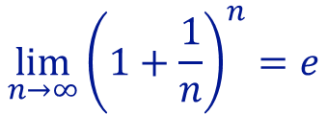






Some well known limits
$$\lim_{x→∞}{\frac{1}{x}=0}$$
$$\lim_{x→0^{+}}{\frac{1}{x}=∞}$$
$$\lim_{x→0^{−}}{\frac{1}{x}=−∞}$$
$$\lim_{θ→0}{\frac{\sin{θ}}{θ}=1}$$
$$\lim_{θ→0}{\frac{\tan{θ}}{θ}=1}$$
$$\lim_{θ→0}{\frac{1−\cos{θ}}{θ^{2}}=\frac{1}{2}}$$
$$\lim_{n→∞}{{\left(1+\frac{1}{n}\right)}^{n}=e}$$
$$\lim_{x→0}{\frac{e^{x}−1}{x}=1}$$
$$\lim_{x→0}{\frac{ln⁡(1+x)}{x}=1}$$
$$\lim_{n→0}{{\left(1+n\right)}^{1/n}=e}$$

Slide 38
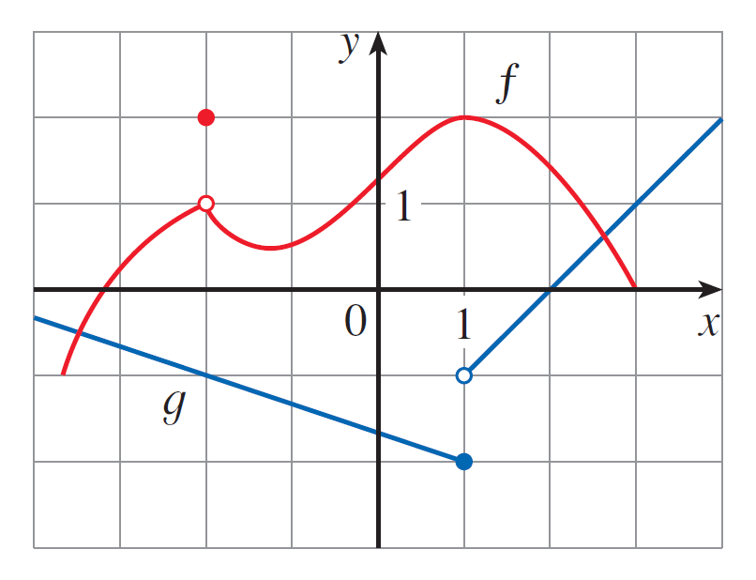
Example 1
Use the Limit Laws and the graphs of f and g in Figure 1 to evaluate the following limits, if they exist.
(a)
(b)
(c)
Figure 1

Slide 39
Example 1(a) – Solution
From the graphs of f and g we see that
Therefore we have
(by Limit Law 1)
(by Limit Law 3)

Slide 40
Example 1(b) – Solution
We see that
But
does not exist because the left
and right limits are different:
So we can’t use Law 4 for the desired limit. But we can use Law 4 for the one-sided limits:
The left and right limits aren’t equal, so
does not exist.

Slide 41
Example 1(c) – Solution
The graphs show that
Because the limit of the denominator is 0, we can’t use Law 5.
The given limit does not exist because the denominator approaches 0 while the numerator approaches a nonzero number.
Figure 1

Slide 42
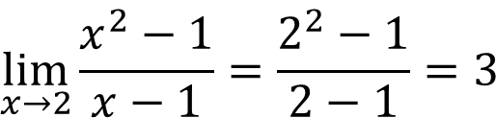

Example 2
$$\lim_{x→2}{\frac{x^{2}−1}{x−1}}$$
Find
Solution:
Let
We can find the limit by substituting x = 2 because f (2) is defined. We apply the Quotient Law, or we can apply direct substitution.
$$\lim_{x→2}{\frac{x^{2}−1}{x−1}=\frac{2^{2}−1}{2−1}=3}$$

Slide 43
Example 3
Find
Solution:
Let
We can’t find the limit by substituting x = 1 because f (1) isn’t defined. Nor can we apply the Quotient Law, because the limit of the denominator is 0.
Instead, we need to do some preliminary algebra. We factor the numerator as a difference of squares:

Slide 44
Example 3 – Solution
The numerator and denominator have a common factor of x − 1. When we take the limit as x approaches 1, we have x ≠ 1 and so x − 1 ≠ 0.
Therefore we can cancel the common factor, x − 1, and then compute the limit by direct substitution as follows:

Slide 45
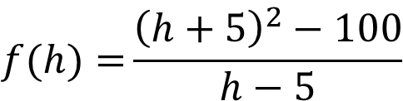
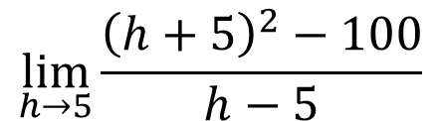
Example 4
Find
$$\lim_{h→5}{\frac{{\left(h+5\right)}^{2}−100}{h−5}}$$
Solution:
Let
$$f(h)={\frac{{\left(h+5\right)}^{2}−100}{h−5}}$$
We can’t find the limit by substituting h = 5
because f (5) isn’t defined. Nor can we apply the Quotient Law, because the
limit of the denominator is 0.
Instead, we need to do some preliminary algebra. We expand the numerator and factor.

Slide 46
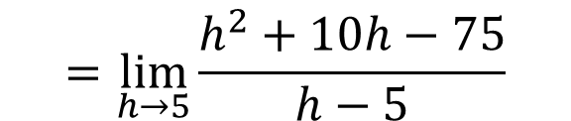
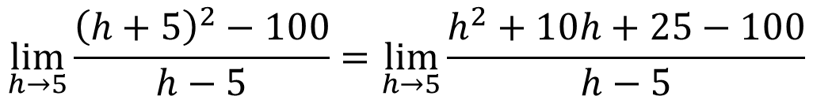


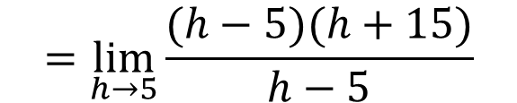
Example 4 - Solution
Solution:
$$\lim_{h→5}{\frac{{\left(h+5\right)}^{2}−100}{h−5}}=\lim_{h→5}{\frac{h^{2}+10h+25−100}{h−5}}$$
$$=\lim_{h→5}{\frac{h^{2}+10h−75}{h−5}}$$
$$=\lim_{h→5}{\frac{(h−5)(h+15)}{h−5}}$$
$$=\lim_{h→5}\left(h+15\right)$$
$$=5+15=20$$

Slide 47
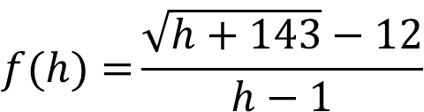
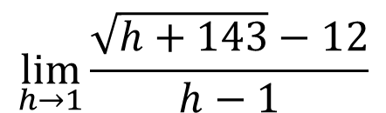
Example 5
Find
$$\lim_{h→1}{\frac{\sqrt{h+143}−12}{h−1}}$$
Solution:
Let
$$f(h)={\frac{\sqrt{h+143}−12}{h−1}}$$
We can’t find the limit by substituting h = 1
because f (1) isn’t defined. Nor can we apply the Quotient Law, because the
limit of the denominator is 0.
Instead, we need to do some preliminary algebra. We rationalize the numerator and then factor.

Slide 48
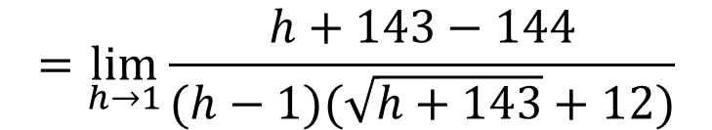



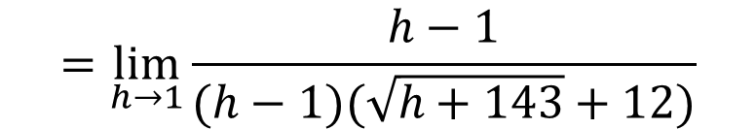
Example 5 - Solution
Solution:
$$\lim_{h→1}{\frac{\sqrt{h+143}−12}{h−1}}=\lim_{h→1}{\frac{\sqrt{h+143}−12}{h−1}}∙\frac{\sqrt{h+143}+12}{\sqrt{h+143}+12}$$
$$=\lim_{h→1}{\frac{h+143−144}{(h−1)(\sqrt{h+143}+12)}}$$
$$=\lim_{h→1}{\frac{h−1}{(h−1)(\sqrt{h+143}+12)}}$$
$$=\lim_{h→1}{\frac{1}{\sqrt{h+143}+12}}$$
$$=\frac{1}{\sqrt{1+143}+12}$$
$$=\frac{1}{24}$$

Slide 49
Using One-Sided Limits
Some limits are best calculated by first finding the left- and right-hand limits.
The following theorem says that a two-sided limit exists if and only if both of the one-sided limits exist and are equal.
Theorem
When computing one-sided limits, we use the fact that the Limit Laws also hold for one-sided limits.

Slide 50




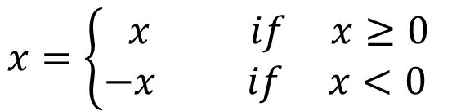
Example 6
Show that
Solution:
We know that
$$x=\left\{\begin{matrix}x if x≥0 \\ −x if x<0 \end{matrix}\right.$$
Since
$$\left|x\right|=x,$$
for x > 0, we have
$$\lim_{x→0^{+}}\left|x\right|=$$
$$\lim_{x→0^{+}}{x}$$
$$=0$$

Slide 51
Example 6 – Solution
For x < 0 we have
and so
Therefore,

Slide 52

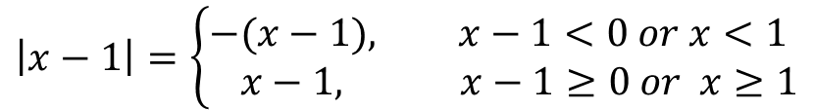
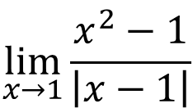
Example 7
$$\lim_{x→1}{\frac{x^{2}−1}{\left|x−1\right|}}$$
Show that
does not exist
Solution:
We know that
By replacing x by x-1 we get
$$\left|x−1\right|=\left\{\begin{aligned}−&(x−1), x−1<0 or x<1 \\ &x−1, x−1≥0 or x≥1\end{aligned}\right.$$
Since
$$\left|x−1\right|=x−1$$
for x > 1, we have
$$\lim_{x→1^{+}}{\frac{x^{2}−1}{\left|x−1\right|}}=\lim_{x→1^{+}}{\frac{x^{2}−1}{x−1}}=\lim_{x→1^{+}}{\frac{(x−1)(x+1)}{x−1}}=\lim_{x→1^{+}}{(x+1)=2}$$

Slide 53

Example 7 – Solution
For x < 1 we have
$\left|x−1\right|=−(x−1$)
and so
$$\lim_{x→1^{−}}{\frac{x^{2}−1}{\left|x−1\right|}}=\lim_{x→1^{−}}{\frac{x^{2}−1}{−(x−1)}}=\lim_{x→1^{−}}{\frac{(x−1)(x+1)}{−(x−1)}}=\lim_{x→1^{−}}{ −\left(x+1\right)=−2}$$
Therefore, limit does not exist

Slide 54
Limit at infinity

Slide 55
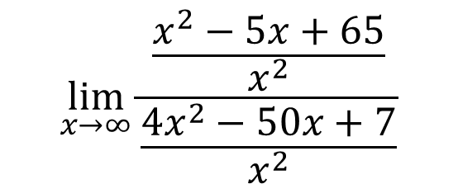
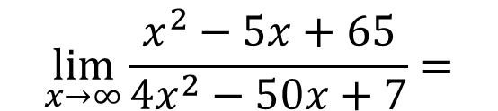
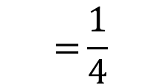
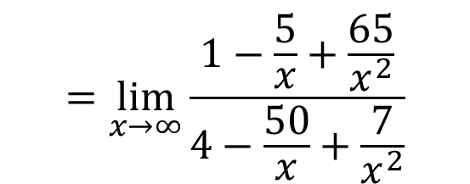
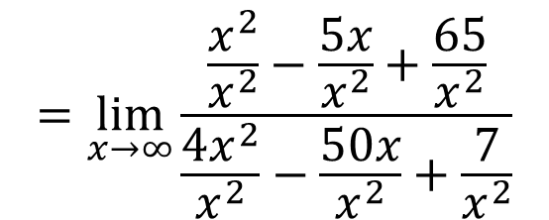
Example 12: Limit at infinity
$$\lim_{x→∞}{\frac{\frac{x^{2}−5x+65}{x^{2}}}{\frac{{4x}^{2}−50x+7}{x^{2}}}}$$
$$\lim_{x→∞}{\frac{x^{2}−5x+65}{{4x}^{2}−50x+7}}=$$
$$=\lim_{x→∞}{\frac{\frac{x^{2}}{x^{2}}−\frac{5x}{x^{2}}+\frac{65}{x^{2}}}{\frac{{4x}^{2}}{x^{2}}−\frac{50x}{x^{2}}+\frac{7}{x^{2}}}}$$
$$=\lim_{x→∞}{\frac{1−\frac{5}{x}+\frac{65}{x^{2}}}{4−\frac{50}{x}+\frac{7}{x^{2}}}}$$
$$={\frac{1}{4}}$$

Slide 56
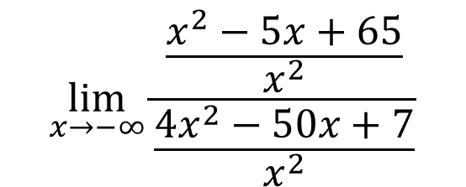
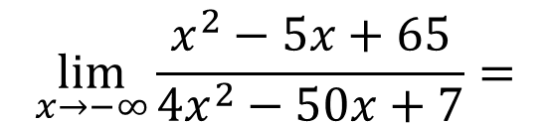
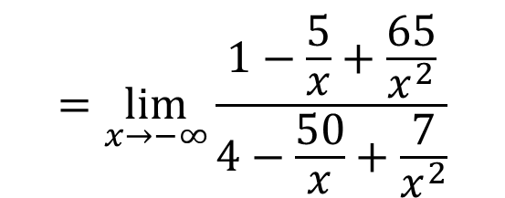
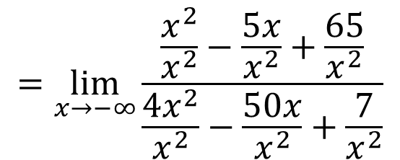
Example 13: Limit at infinity
$$\lim_{x→−∞}{\frac{\frac{x^{2}−5x+65}{x^{2}}}{\frac{{4x}^{2}−50x+7}{x^{2}}}}$$
$$\lim_{x→−∞}{\frac{x^{2}−5x+65}{{4x}^{2}−50x+7}}=$$
$$=\lim_{x→−∞}{\frac{\frac{x^{2}}{x^{2}}−\frac{5x}{x^{2}}+\frac{65}{x^{2}}}{\frac{{4x}^{2}}{x^{2}}−\frac{50x}{x^{2}}+\frac{7}{x^{2}}}}$$
$$=\lim_{x→−∞}{\frac{1−\frac{5}{x}+\frac{65}{x^{2}}}{4−\frac{50}{x}+\frac{7}{x^{2}}}}$$
$$={\frac{1}{4}}$$

Slide 57
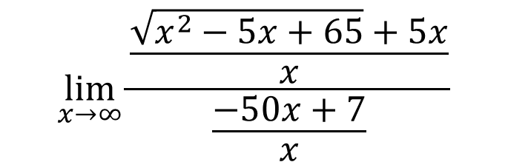
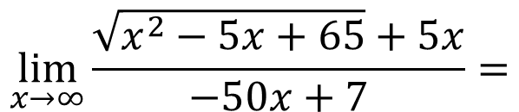
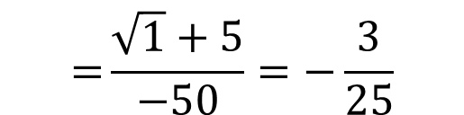
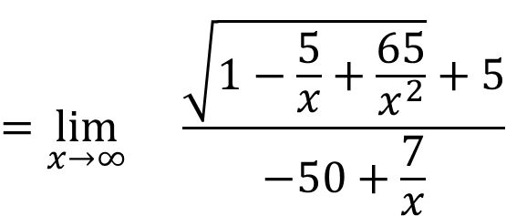
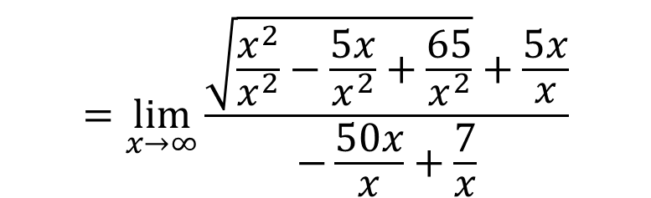
Example 12: Limit at infinity
$$\lim_{x→∞}{\frac{\frac{\sqrt{x^{2}−5x+65}+5x}{x}}{\frac{−50x+7}{x}}}$$
$$\lim_{x→∞}{\frac{\sqrt{x^{2}−5x+65}+5x}{−50x+7}}=$$
$$=\lim_{x→∞}{\frac{\sqrt{\frac{x^{2}}{x^{2}}−\frac{5x}{x^{2}}+\frac{65}{x^{2}}}+\frac{5x}{x}}{−\frac{50x}{x}+\frac{7}{x}}}$$
$$=\lim_{x→∞}{}\frac{\sqrt{1−\frac{5}{x}+\frac{65}{x^{2}}}+5}{−50+\frac{7}{x}}$$
$$={\frac{\sqrt{1}+5}{−50}}=−\frac{3}{25}$$

Slide 58
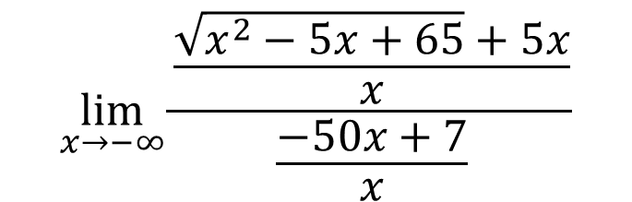
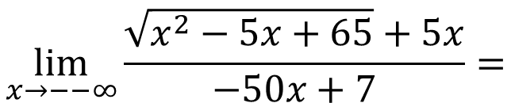
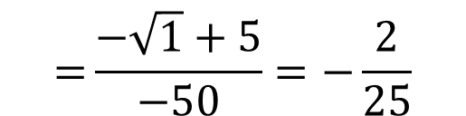
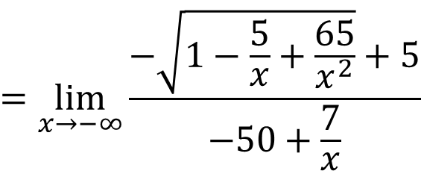

Example 13: Limit at infinity
$$\lim_{x→−∞}{\frac{\frac{\sqrt{x^{2}−5x+65}+5x}{x}}{\frac{−50x+7}{x}}}$$
$$\lim_{x→−−∞}{\frac{\sqrt{x^{2}−5x+65}+5x}{−50x+7}}=$$
$$=\lim_{x→−∞}{\frac{−\sqrt{\frac{x^{2}}{x^{2}}−\frac{5x}{x^{2}}+\frac{65}{x^{2}}}+\frac{5x}{x}}{−\frac{50x}{x}+\frac{7}{x}}}$$
$$=\lim_{x→−∞}{\frac{−\sqrt{1−\frac{5}{x}+\frac{65}{x^{2}}}+5}{−50+\frac{7}{x}}}$$
$$={\frac{−\sqrt{1}+5}{−50}}=−\frac{2}{25}$$

Slide 59





Example 14: Limit at infinity
$$\underset{x→∞}{=lim}{\frac{\left(\sqrt{{25x}^{2}+4x+65}−5x\right)\left(\sqrt{{25x}^{2}+4x+65}+5x\right)}{\sqrt{{25x}^{2}+4x+65}+5x}}$$
$$\lim_{x→∞}\left[\sqrt{{25x}^{2}+4x+65}−5x\right]$$
$$=\lim_{x→∞}{\frac{{25x}^{2}+4x+65−{25x}^{2}}{\sqrt{{25x}^{2}+4x+65}+5x}}$$
$$=\lim_{x→∞}{\frac{4x+65}{\sqrt{{25x}^{2}+4x+65}+5x}}$$
$$=\lim_{x→∞}{\frac{4+\frac{65}{x}}{\frac{\sqrt{{25x}^{2}+4x+65}}{x}+5}}$$

Slide 60




Example 14: Limit at infinity
$$=\lim_{x→∞}{\frac{4+\frac{65}{x}}{\sqrt{\frac{{25x}^{2}+4x+65}{x^{2}}}+5}}$$
$$=\lim_{x→∞}{\frac{4+\frac{65}{x}}{\sqrt{25+\frac{4}{x}+\frac{65}{x^{2}}}+5}}$$
$$=\frac{4+0}{\sqrt{25+0+0}+5}$$
$$=\frac{4}{10}=\frac{2}{5}$$

Slide 61

Example 14: Limit at infinity

Slide 62
The Squeeze Theorem
If f (x) ≤ g(x) ≤ h(x) when x is near a (except possibly at a) and
then

Slide 63

The Squeeze Theorem
The Squeeze Theorem, which is sometimes called the Sandwich Theorem or the Pinching Theorem, is illustrated by Figure 7.
Figure 7
It says that if g (x) is squeezed between f (x) and h (x) near a, and if f and h have the same limit L at a, then g is forced to have the same limit L at a.

Slide 64
Example 15
Show that
Solution:
First note that we cannot rewrite the limit as the product of the limits
does not exist.
We can find the limit by using the Squeeze Theorem.

Slide 65
Example 15 – Solution (1 of 3)
To apply the Squeeze Theorem we need to find a function f smaller than
and a function h bigger than g such that both f (x) and h(x) approach 0 as x → 0.
To do this we use our knowledge of the sine function. Because the sine of any number lies between −1 and 1, we can write

Slide 66

Example 15 – Solution (2 of 3)
Any inequality remains true when multiplied by a positive number. We know that
for all x and so, multiplying each side of the inequalities in (4) by
we get
as illustrated by Figure 8.
Figure 8

Slide 67
Example 15 – Solution (3 of 3)
We know that
Taking
in the Squeeze Theorem,
we obtain

